Slide 1
Save Brescia Norton!!!
By: Kashawn Brown, Oluwadamilola Kadiri, Oladayo Ogunjimi

Slide 2

CASE STUDY
Brescia Norton NEEDS US!
Let’s leverage Machine Learning

Slide 3

Data Preprocessing
Indexing
Full Date Calculation
Missing Data
Categorical Data
New Processed Data

Slide 4

Feature Selection
Correlation ?
Examining given data
Researching Feature Selection Techniques
Our Final Decision:
Chi² ?
ANOVA ?

Slide 5
Mutual Information Classifier

Slide 6
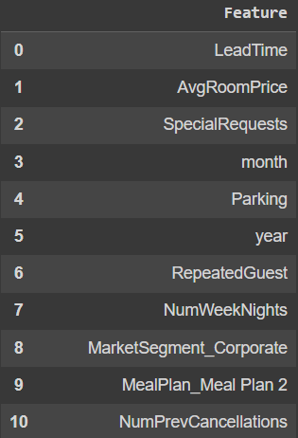
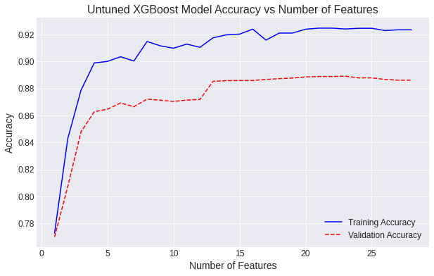
Feature Selection: Our Results

Slide 7
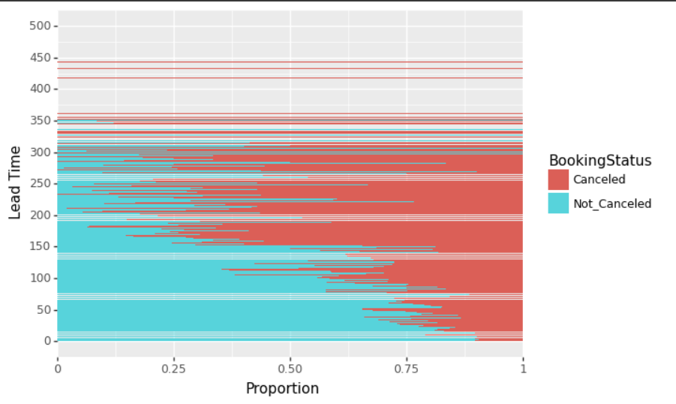
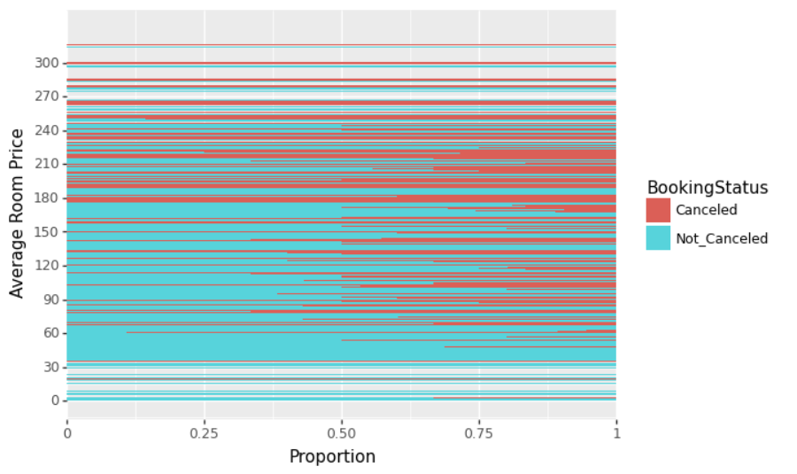
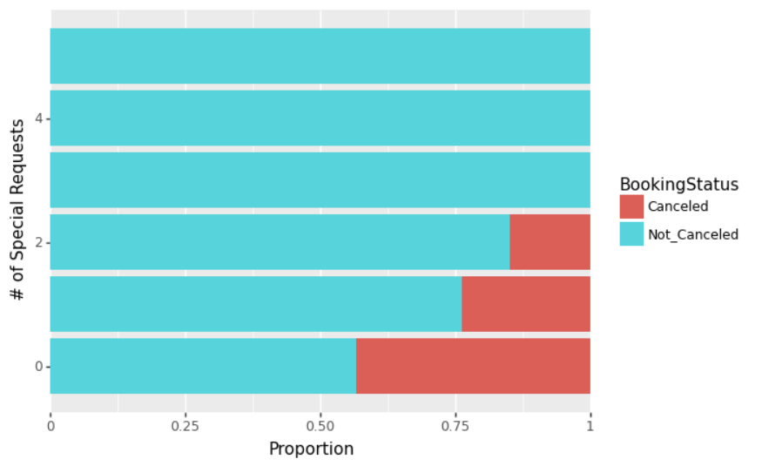
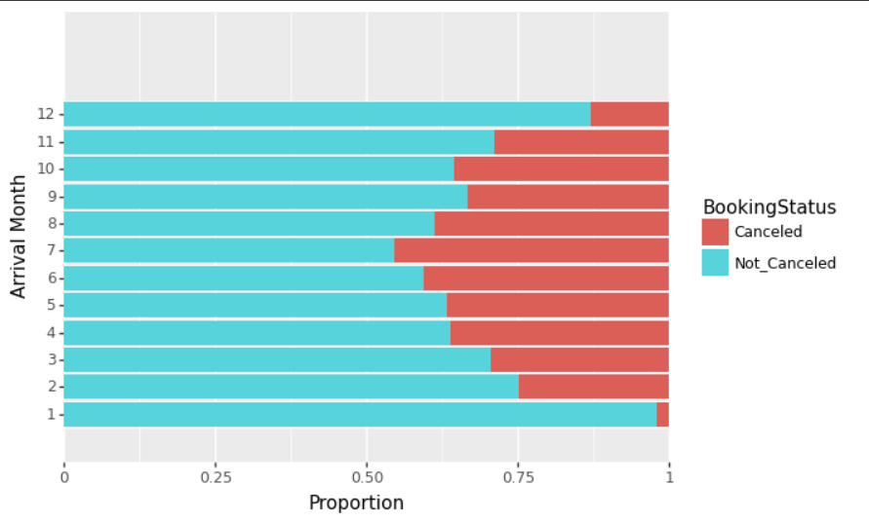
Feature Selection: Our Results

Slide 8
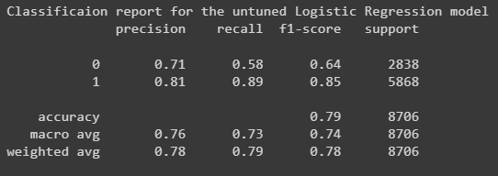
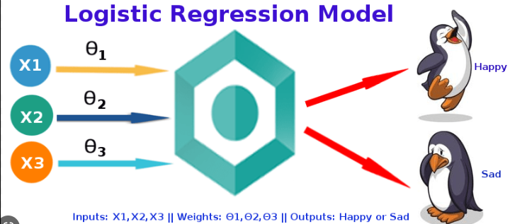
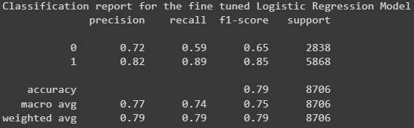
Model Selection - Logistic Regression
Simplest to implement
Good for Linear relationships

Slide 9
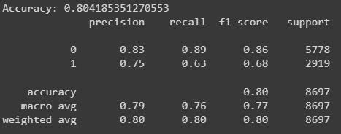
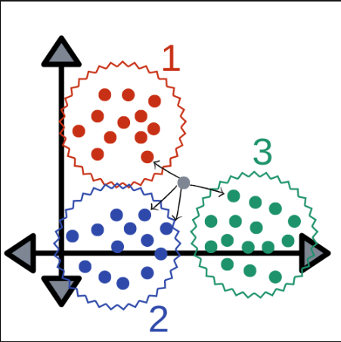
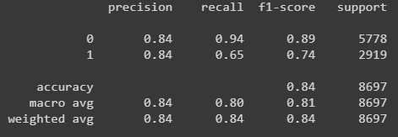
Model Selection - KNN
Can handle nonlinear decision boundaries
Good for classification type problems
Better for larger datasets

Slide 10
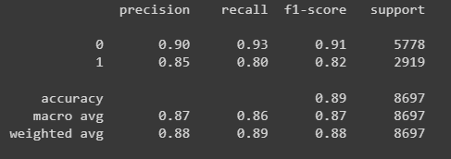
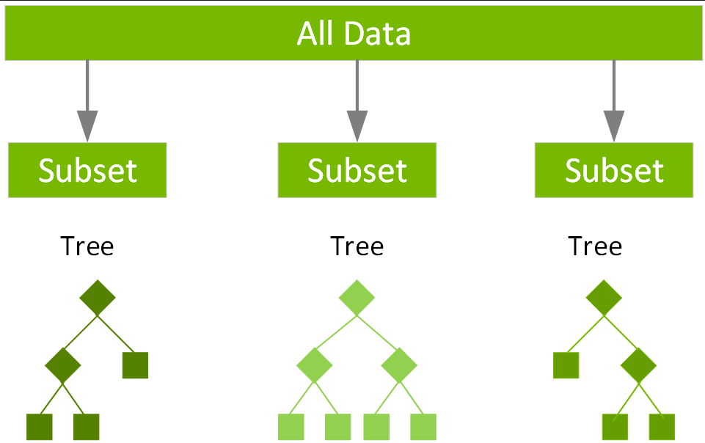
Model Selection - XGBoost
Has built in L1 and L2 regularization techniques to minimize overfitting
Can automatically stop once the model’s performance stops improving

Slide 11
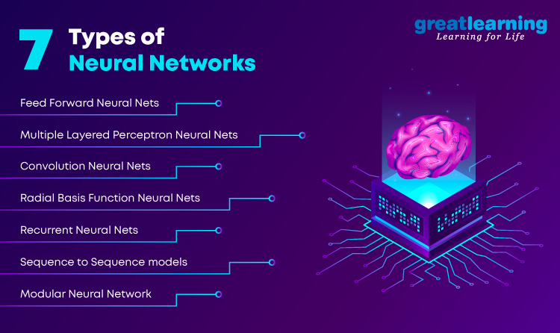
Performance upgrade with Deep Learning

Slide 12
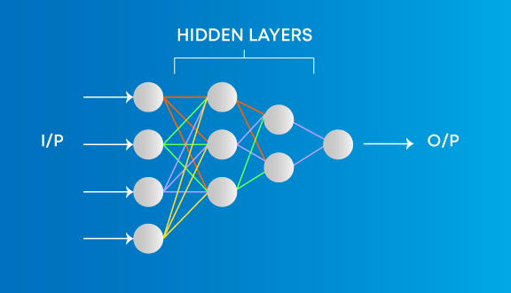
Multi-Layer Perceptrons

Slide 13
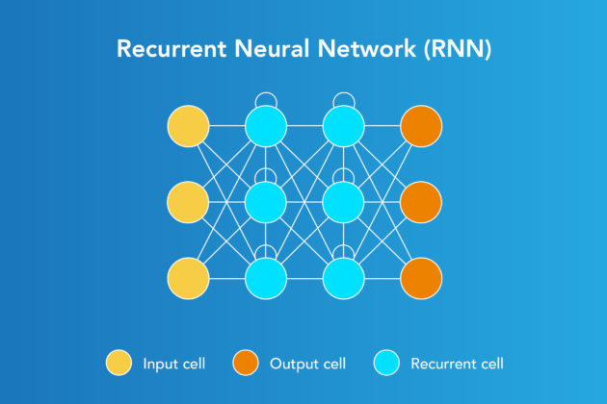
Recurrent Neural Networks

Slide 14
Model Performance - MLP
5 fully connected layers, with 18, 200, 1000, 1000, and 810 units,
Activation: ReLU & SoftMax
Optimizer - Adam
Validation Accuracy: Approx 83%

Slide 15
Model Performance - MLP-XGBoost
MLP-XGB Validation Accuracy: 0.8492583649534322
MLP-XGB Training Accuracy: 0.8772362130994037
precision recall f1-score support
0 0.86 0.93 0.89 5778
1 0.83 0.70 0.76 2919
accuracy 0.85 8697
macro avg 0.84 0.81 0.82 8697
weighted avg 0.85 0.85 0.85 8697

Slide 16
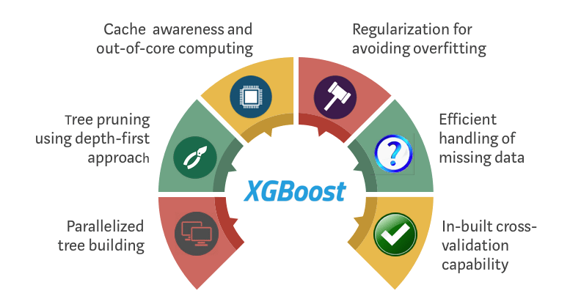
Conclusion - Best Model

Slide 17
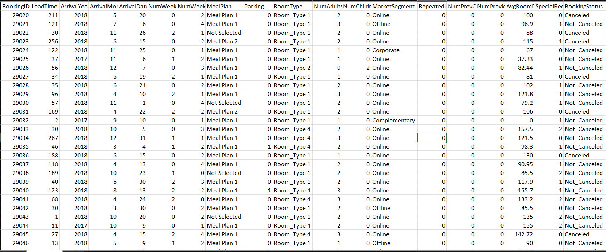
Conclusion - Our Predictions

Slide 18
Conclusion
Thank you

